Slide 1
Mystery Cans
Healthy or Unhealthy?

Slide 2
Today’s Problem
Help me match the nutrition labels to each can.
Read the nutrition labels and use what you know about “healthy” to make a good guess as to which can has…
The most healthy ingredient.
The somewhat healthy ingredient.
The least healthy ingredient.
?

Slide 3
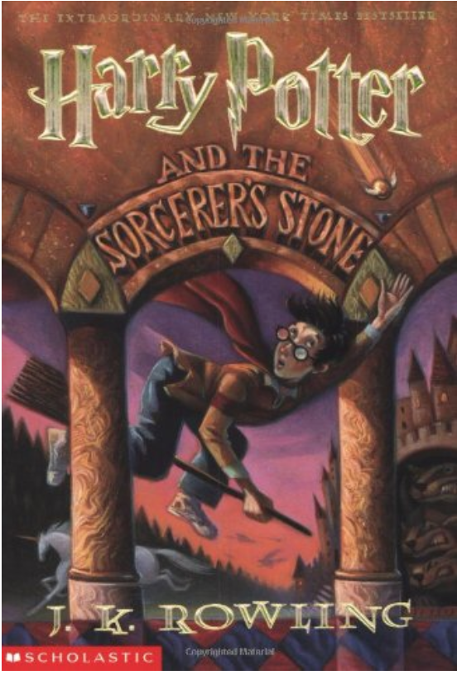
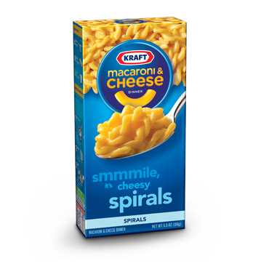
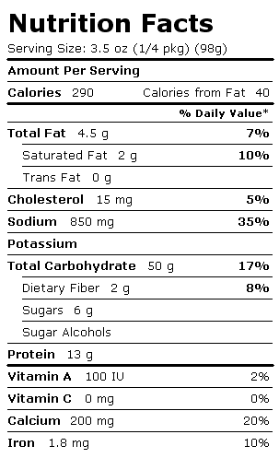
Nutrition Facts Labels
Tell us what is inside our food!
Notes:
You guys did a great job analyzing your nutrition facts labels! So, why do you think foods have nutrition facts labels? How are they helpful? (Students respond)
Great ideas! Yes, just like the summary on the back of a book, a nutrition facts label gives us a summary of what is in our food.

Slide 4
Nutrients
Protein
Fat
Sodium
Carbohydrates
Notes:
Now that we know what a nutrition facts label tells us, what do you think nutrients are? What might this picture tell us about nutrients? (Students respond)
Nutrients are the building blocks of our food. They support our body and lead to good health. Foods have lots of different kinds of nutrients, but today we are going to focus on four: fat, sodium, protein, and carbohydrates.

Slide 5
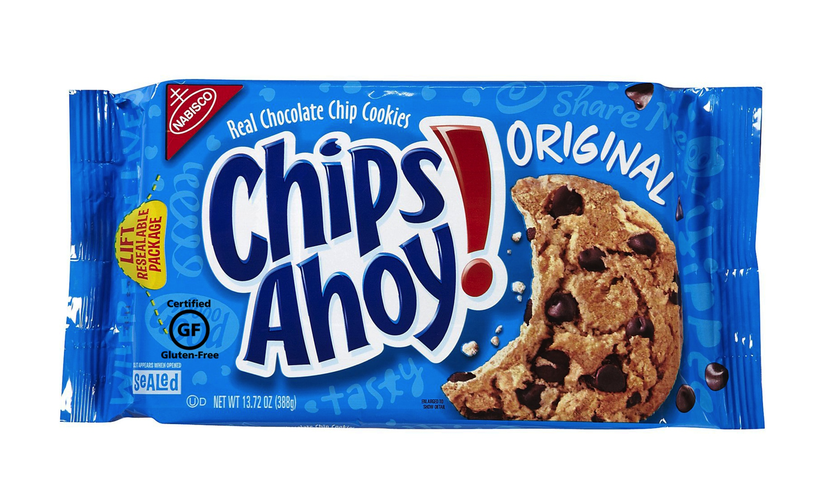
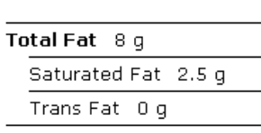
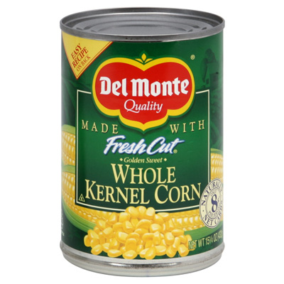
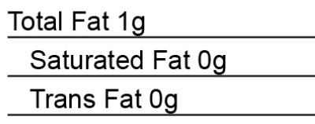
Fat
Notes:
Our bodies like to have a lot of some nutrients and a little of others. What did the amount of fat on your nutrition labels tell you? Do you think healthier foods have a lot of fat or a little fat?
Fat is a nutrient in foods that helps our body store energy. We eat food so we have the energy to run, talk, and play later. There are good fats that come from natural things and bad fats that people put in food to make it taste better. It is important that we only eat a little fat so our body has enough room to store it.
Based on these nutrition labels, which food do you think is healthier, the first or second? Yes, the second one, corn, is healthier because it only has 1g of fat and the first one, cookies, has 8g of fat.

Slide 6
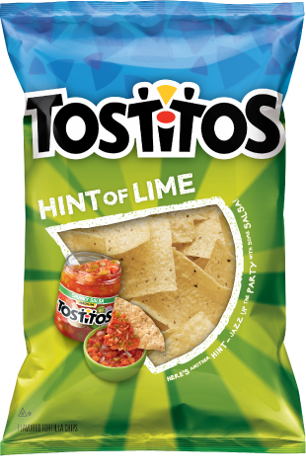
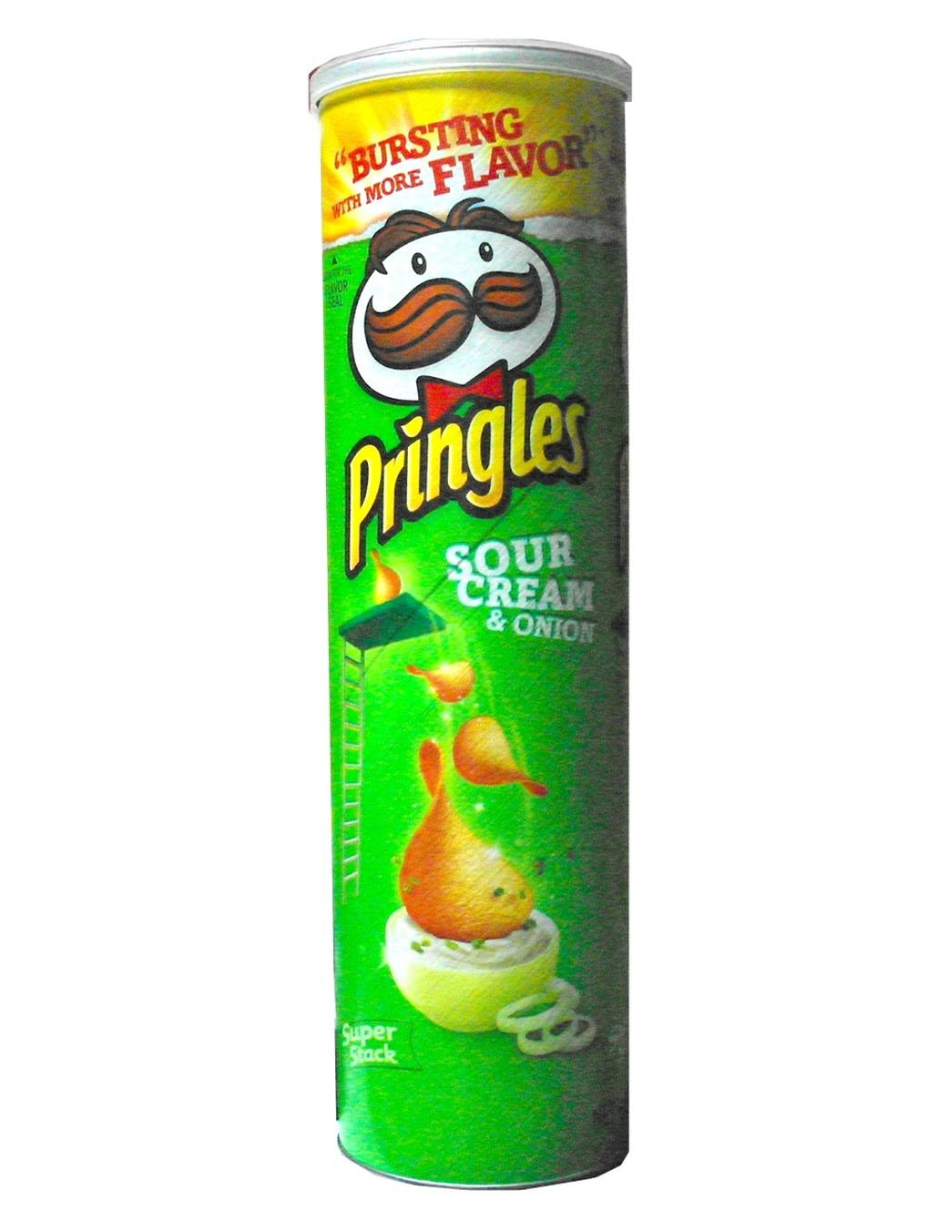
Sodium
Notes:
What do you think sodium is? What did the amount of sodium on your nutrition facts label tell you? Do you think healthier foods have a lot or a little sodium?
Sodium is salt, a nutrient in food that adds flavoring. We don’t want to eat foods that have too much because it can make it hard for our heart to pump blood all over our body.
Both of these foods are pretty high in sodium. But if we had to choose between the two, which food do you think is healthier based on sodium? Yes, Tostitos are healthier than Pringles because they have 160mg of sodium rather than 180mg of sodium for the same amount of chips.

Slide 7
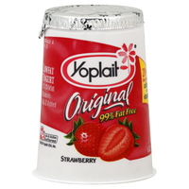
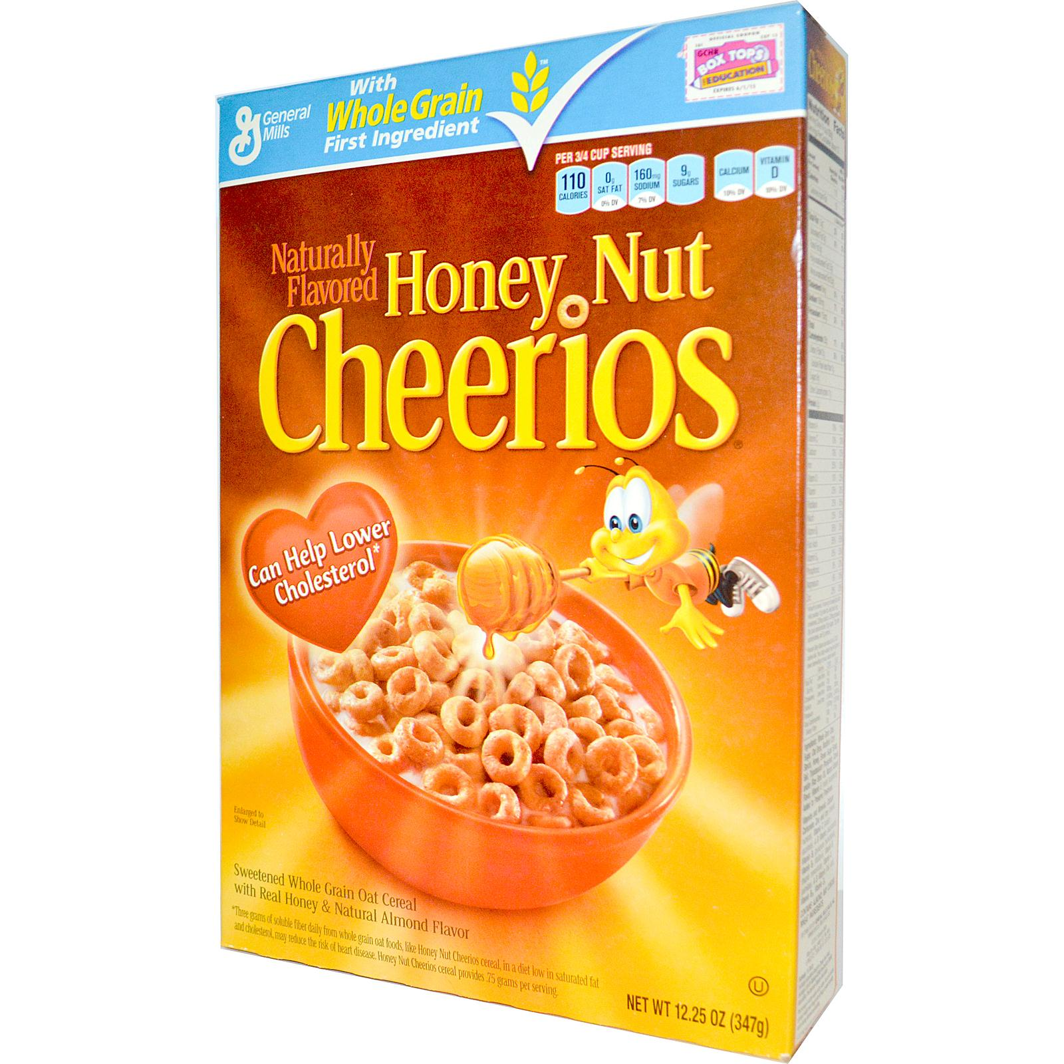
Carbohydrates
Notes:
What do you think carbohydrates or carbs are? What did the amount of carbs on your nutrition facts label tell you? Do you think healthier foods have more or less carbs?
Carbohydrates are nutrients that provide the body with heat and energy. Sugar is a type of carbohydrate. We need foods with carbohydrates because they give us energy, but we don’t want to eat too much or our body will store the extra energy as fat. Also, we don’t want to eat too much sugar because it is bad for our teeth.
Based on these nutrition labels, which food do you think is healthier, the first or second? Yes, the second one, Cheerios, is healthier because it only has 22g of carbs and 9g of sugar and the first one, yogurt, has 33g of carbs and 26g of sugar.

Slide 8
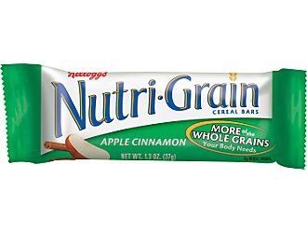
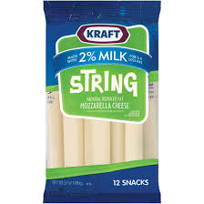
Protein
Notes:
What do you think protein is? What did the amount of protein on your nutrition facts label tell you? Do you think healthier foods have more or less protein?
Protein is a nutrient that helps the body grow by building muscles and bones. We want to eat foods with lots of protein so our body can get bigger and stronger.
Based on these nutrition labels, which food do you think is healthier? Yes, the second one, string cheese, is healthier because it has 7g of protein where the Nutri-Grain bar only has 2g of protein.

